Slide 1
Please click on the “slide show” tab on the top bar and “From Beginning” tab to start the Activity

Slide 2
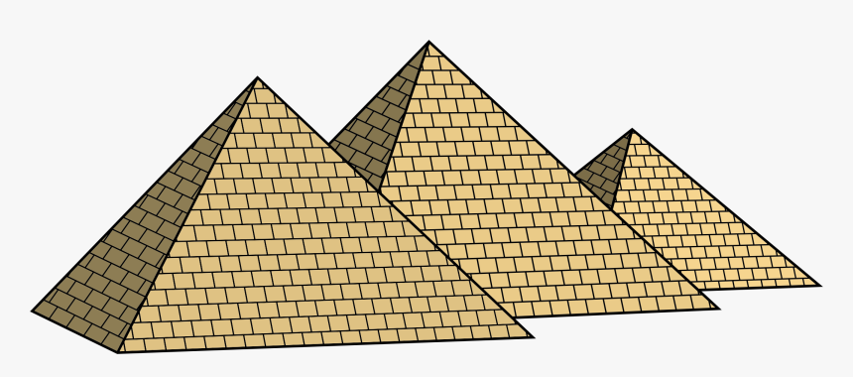
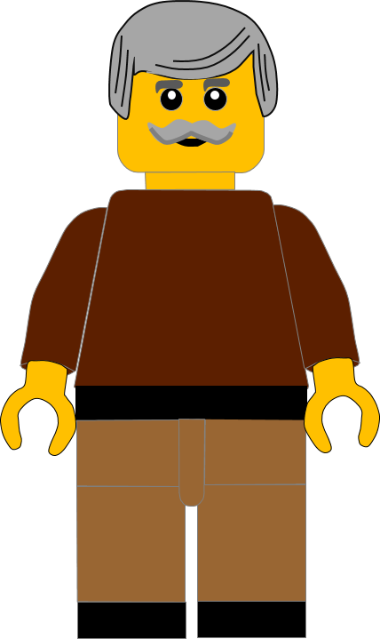
In this activity you will be given 10 questions about the story of Moses and the 10 commandments which you can find in Exodus 20.
You will be given 3 possible answers to each question and you have to choose the right one.
Click here to start the quiz

Slide 3
Question 1:
What does the 8th commandment tell us not do?
Murder
Lie
Steal
Press your answer

Slide 4
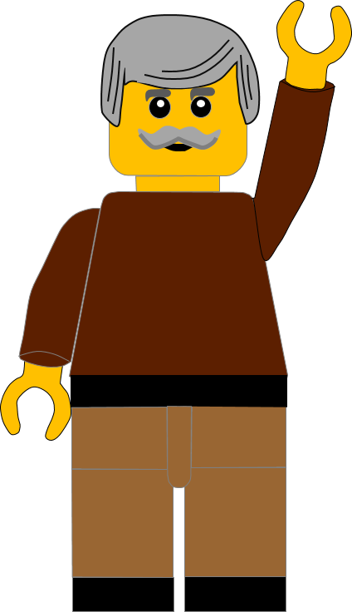
Question 1:
What does the 8th commandment tell us not do?
Murder
Lie
Steal
You are right.
The 8th commandment tells us not to STEAL.
Well Done
Click for the next question

Slide 5
Question 2:
What does the 5th commandment say we should do to our parents?
Hide from them
Honour them
Hurt them
Press your answer

Slide 6
Question 2:
What does the 5th commandment say we should do to our parents?
Hide from them
Honour them
Hurt them
You are correct.
The 5th commandment tells us to HONOUR our father and mother.
Well Done
Click for the next question

Slide 7
Question 3:
What does the 9th commandment tell us not do?
Murder
Lie
Steal
Press your answer

Slide 8
Question 3:
What does the 9th commandment tell us not do?
Murder
Lie
Steal
Fantastic answer.
The 9th commandment tells us not to LIE.
Well Done
Click for the next question

Slide 9
Question 4:
The 10th commandment tells us that we must not _ _ _ _ other people’s things ?
Want
Love
Hate
Press your answer

Slide 10
Question 4:
The 10th commandment tells us that we must not _ _ _ _ other people’s things ?
Want
Love
Hate
Great answer.
The 10th commandment tells us that we must not WANT other people’s things.
Well Done
Click for the next question

Slide 11
Question 5:
What does the 4th commandment say we should do with the Sabbath day?
Go on holiday
Make it horrible
Keep it holy
Press your answer

Slide 12
Question 5:
What does the 4th commandment say we should do with the Sabbath day?
Go on holiday
Make it horrible
Keep it holy
You are correct.
The 4th commandment tells us to keep the Sabbath HOLY.
Well Done
Click for the next question

Slide 13
Question 6:
What word describes how we feel when we want someone else’s things?
Jealous
Jellified
Jittery
Press your answer

Slide 14
Question 6:
What word describes how we feel when we want someone else’s things?
Jealous
Jellified
Jittery
You are right.
We feel JEALOUS when we want other people’s things.
Well Done
Click for the next question

Slide 15
Question 7:
Who did Jesus say we should love in Matthew 22?
Our nanny
Our neighbour
Our new friend
Press your answer

Slide 16
Question 7:
Who did Jesus say we should love in Matthew 22?
Our nanny
Our neighbour
Our new friend
Spot on answer.
Jesus said to love OUR NEIGHBOURS as ourselves.
Well Done
Click for the next question

Slide 17
Question 8:
What did the 2nd commandment tell us not to make for ourselves?
Promises
Plans
Idols
Press your answer

Slide 18
Question 8:
What did the 2nd commandment tell us not to make for ourselves?
Promises
Plans
Idols
Great answer.
The 2nd Commandments tells us not to make IDOLS for ourselves.
Well Done
Click for the next question

Slide 19
Question 9:
In the 6th Commandment God tells Moses not to . . . . anyone?
Marry
Murder
Move
Press your answer

Slide 20
Question 9:
In the 6th Commandment God tells Moses not to . . . . anyone?
Marry
Murder
Move
Fantastic answer.
The 6nd Commandment tells us not to MURDER anyone.
Well Done
Click for the next question

Slide 21
Question 10:
Why did God give the Israelites the Ten Commandments?
To show them how to live
To stop them having fun
To make hard rules for them
Press your answer

Slide 22
Question 10:
Why did God give the Israelites the Ten Commandments?
To show them how to live
To stop them having fun
To make hard rules for them
That’s the right answer.
God gave the Israelites the 10 Commandments TO SHOW THEM HOW TO LIVE.
Well Done
Click for the next question

Slide 23
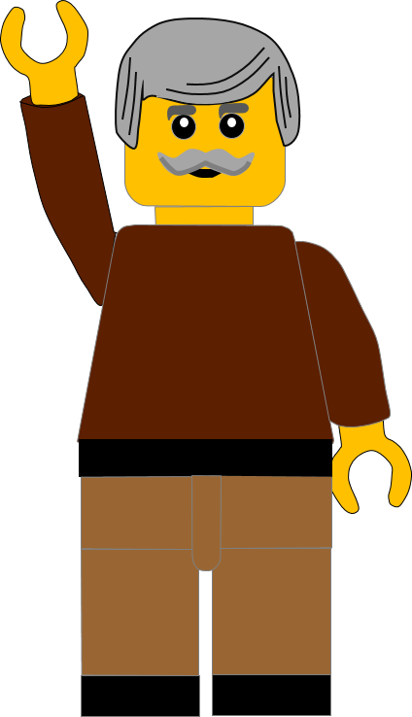
Well done for finishing the quiz.
I’ll have another one for you next week.
See you next time

Slide 24
Whoops!
That’s not quite right.
Try again.
Click to return to the quiz

