Slide 1
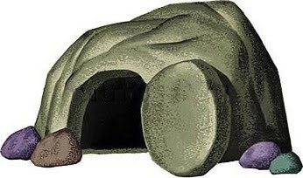
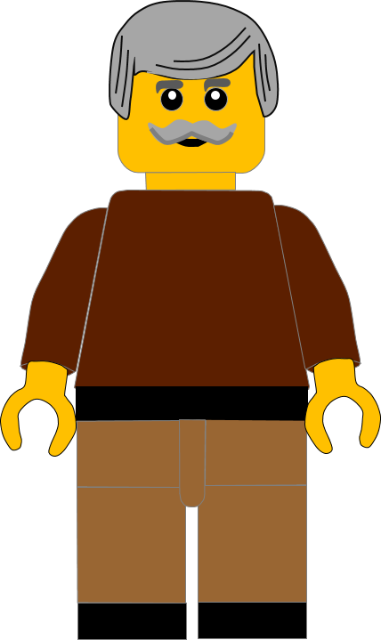
In this activity you will be given 10 questions about the story of Jesus coming back to life in
Matthew chapter 28 v 1 - 10.
You will be given 3 possible answers to each question and you have to choose the right one.
Click here to start the quiz

Slide 2
Question 1:
On which day of the week did our story happen?
Sabbath Day
Wednesday
Christmas Day
Press your answer

Slide 3
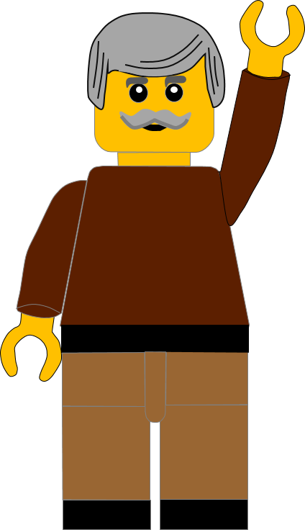
Question 1:
On which day of the week did our story happen?
Sabbath Day
Wednesday
Christmas Day
You are correct.
Today’s story happens on the SABBATH DAY.
Well Done
Click for the next question

Slide 4
Question 2:
What was the name of the women who went to the tomb?
Miriam
Mary
Martha
Press your answer

Slide 5
Question 2:
What was the name of the women who went to the tomb?
Miriam
Mary
Martha
You are right.
Both of the women were named MARY.
Well Done
Click for the next question

Slide 6
Question 3:
What time of day did the women go to the tomb?
Dawn
Midday
Evening
Press your answer

Slide 7
Question 3:
What time of day did the women go to the tomb?
Dawn
Midday
Evening
Fantastic answer.
The women went very early at DAWN.
Well Done
Click for the next question

Slide 8
Question 4:
What happened when the women got to the tomb?
A Volcano erupted
A Hurricane blew
An Earthquake shook
Press your answer

Slide 9
Question 4:
What happened when the women got to the tomb?
A Volcano erupted
A Hurricane blew
An Earthquake shook
Fantastic answer.
When the women got to the tomb an EARTHQUAKE shook the earth.
Well Done
Click for the next question

Slide 10
Question 5:
Who rolled the heavy stone away from the tomb entrance?
The Guards
An Angel
Lego Builders
Press your answer

Slide 11
Question 5:
Who rolled the heavy stone away from the tomb entrance?
The Guards
An Angel
Lego Builders
Great answer.
AN ANGEL rolled the stone away.
Well Done
Click for the next question

Slide 12
Question 6:
What were the angel’s clothes like?
White as
new lambs
White as
ice cream
White as
snow
Press your answer

Slide 13
Question 6:
What were the angel’s clothes like?
White as
new lambs
White as
ice cream
White as
snow
You are correct.
The angel’s clothes were WHITE AS SNOW.
Well Done
Click for the next question

Slide 14
Question 7:
What did the angel say had happened to Jesus?
He had gone to heaven
He had risen
He had been moved
Press your answer

Slide 15
Question 7:
What did the angel say had happened to Jesus?
He had gone to heaven
He had risen
He had been moved
You are right.
The angel said Jesus HAD RISEN and they would meet him in Galilee.
Well Done
Click for the next question

Slide 16
Question 8:
Who met the women when they left the tomb?
Simon Peter
James
Jesus
Press your answer

Slide 17
Question 8:
Who met the women when they left the tomb?
Simon Peter
James
Jesus
Spot on answer.
JESUS met the women as they were leaving the tomb.
Well Done
Click for the next question

Slide 18
Question 9:
What did Jesus tell the women NOT to be?
Glad
Brave
Afraid
Press your answer

Slide 19
Question 9:
What did Jesus tell the women NOT to be?
Glad
Brave
Afraid
Great answer.
Jesus told the women NOT to be AFRAID.
Well Done.
Click for the next question

Slide 20
Question 10:
Where did Jesus tell the disciples to go to?
Bethlehem
Galilee
Jerusalem
Press your answer

Slide 21
Question 10:
Where did Jesus tell the disciples to go to?
Bethlehem
Galilee
Jerusalem
That’s the right answer.
Jesus told the disciples to go to GALILEE.
Well Done
Click for the next question

Slide 22
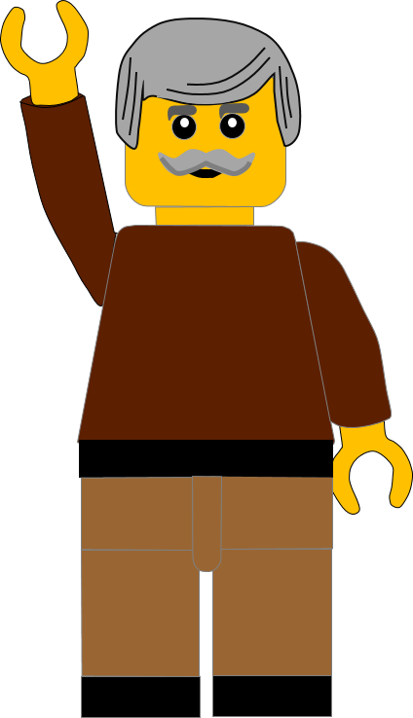
Well done for finishing the quiz.
I’ll have another one for you next week.
See you next time

Slide 23
Whoops!
That’s not quite right.
Try again.
Click to return to the quiz

