Slide 1
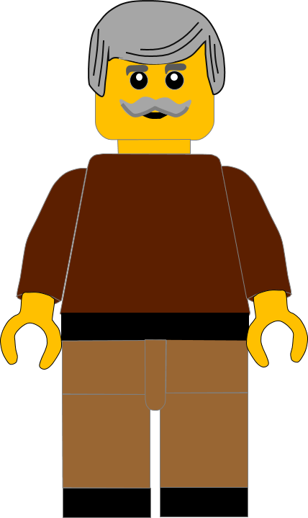
In this activity you will be given 10 questions about the story of the Good Samaritan in
Luke chapter 10 v25 -37 and the Fruit of the Spirit in Galatians 5 v22-23.
You will be given 3 possible answers to each question and you have to choose the right one.
Goodness
Click here to start the quiz

Slide 2
Question 1:
How many Fruit of the Spirit does Galatians 5 v22 tell us?
Seven
Eight
Nine
Press your answer

Slide 3
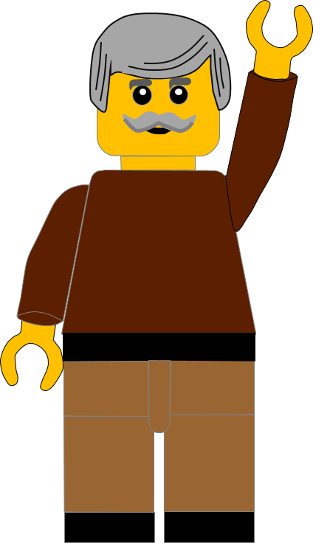
Question 1:
How many Fruit of the Spirit does Galatians 5 v22 tell us?
Seven
Eight
Nine
You are correct.
There are NINE Fruit of the Spirit listed in Galatians 5 v22.
Well Done
Click for the next question

Slide 4
Question 2:
Which Fruit comes just before Goodness in the Galatians list?
Patience
Kindness
Gentleness
Press your answer

Slide 5
Question 2:
Which Fruit comes just before Goodness in the Galatians list?
Patience
Kindness
Gentleness
You are right.
KINDNESS is listed just before GOODNESS.
Well Done
Click for the next question

Slide 6
Question 3:
Where was the man travelling to in the Good Samaritan parable?
Jericho
Bethlehem
Bethany
Press your answer

Slide 7
Question 3:
Where was the man travelling to in the Good Samaritan parable?
Jericho
Bethlehem
Bethany
Fantastic answer.
The man was travelling from
Jerusalem to JERICHO.
Well Done
Click for the next question

Slide 8
Question 4:
Who met the man first on the road?
Priest
Wisemen
Robbers
Press your answer

Slide 9
Question 4:
Who met the man first on the road?
Priest
Wisemen
Robbers
Fantastic answer.
The man was first met by ROBBERS who beat him up.
Well Done
Click for the next question

Slide 10
Question 5:
Who came along the road next?
A Priest
A Shepherd
A Tax collector
Press your answer

Slide 11
Question 5:
Who came along the road next?
A Priest
A Shepherd
A Tax collector
Great answer.
The next person to see the man was a PRIEST.
Well Done
Click for the next question

Slide 12
Question 6:
How did the Priest help the man?
Bandaged his wounds
Gave him some new clothes
He didn’t help him
Press your answer

Slide 13
Question 6:
How did the Priest help the man?
Bandaged his wounds
Gave him some new clothes
He didn’t help him
You are correct.
The Priest DIDN’T HELP HIM.
He passed by on the other side of the road.
Well Done
Click for the next question

Slide 14
Question 7:
Who came after the Priest on the road?
A Farmer
A Levite
A Soldier
Press your answer

Slide 15
Question 7:
Who came after the Priest on the road?
A Farmer
A Levite
A Soldier
You are right.
The next person to come along the road was A LEVITE.
Well Done
Click for the next question

Slide 16
Question 8:
How did the Levite help the man?
He gave him some water
He prayed for him
He didn’t help him
Press your answer

Slide 17
Question 8:
How did the Levite help the man?
He gave him some water
He prayed for him
He didn’t help him
Spot on answer.
The Levite DIDN’T HELP THE MAN.
He passed by on the other side of the road
Well Done
Click for the next question

Slide 18
Question 9:
Who came after the Levite on the Road?
An inn keeper
A Samaritan
A doctor
Press your answer

Slide 19
Question 9:
Who came after the Levite on the Road?
An inn keeper
A Samaritan
A doctor
Great answer.
The SAMARITAN came along the road.
Well Done.
Click for the next question

Slide 20
Question 10:
What did the Samaritan do to help the man?
Walked past the man
Took his money
Bandaged his wounds
Press your answer

Slide 21
Question 10:
What did the Samaritan do to help the man?
Walked past the man
Took his money
Bandaged his wounds
That’s the right answer.
The Samaritan BANDAGED HIS WOUNDS and then took him to an inn, to care for him there.
Well Done
Click for the next question

Slide 22
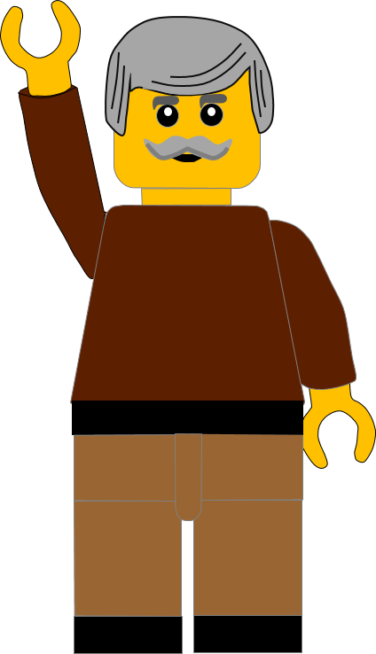
Well done for finishing the quiz.
I’ll have another one for you next week.
See you next time
Goodness

Slide 23
Whoops!
That’s not quite right.
Try again.
Goodness
Click to return to the quiz

