Slide 1
Please click on the “slide show” tab on the top bar and “From Beginning” tab to start the Activity

Slide 2
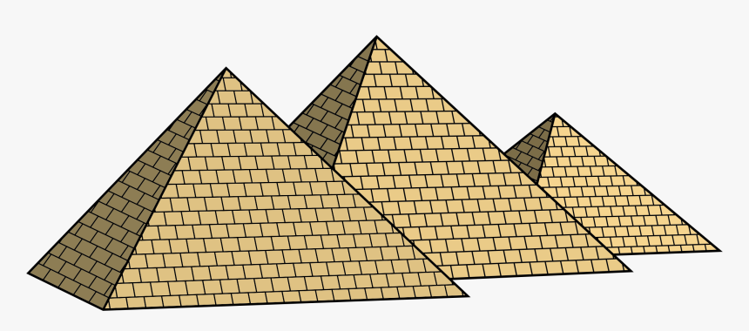
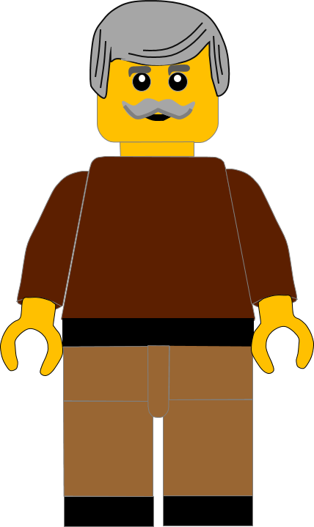
In this activity you will be given 10 questions about the story of Moses and the Red Sea, which you can find in Exodus 13 and 14.
You will be given 3 possible answers to each question and you have to choose the right one.
Click here to start the quiz

Slide 3
Question 1:
Whose bones did the Israelites take with them?
Abraham’s
Joseph’s
Jacob’s
Press your answer

Slide 4
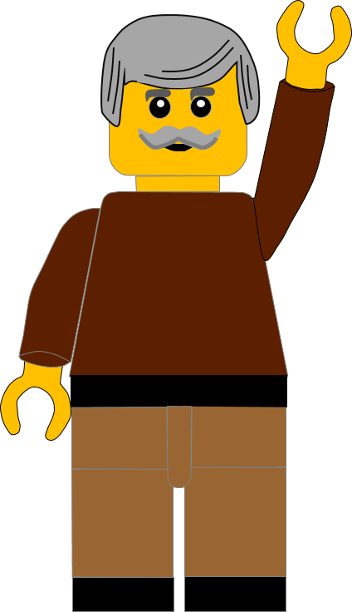
Question 1:
Whose bones did the Israelites take with them?
Abraham’s
Joseph’s
Jacob’s
You are right.
Joseph made the Israelites promise to take his bones.
Well Done
Click for the next question

Slide 5
Question 2:
What went in front of the Israelites during the daytime?
Pillar of cloud
The sun
A dove
Press your answer

Slide 6
Question 2:
What went in front of the Israelites during the daytime?
Pillar of cloud
The sun
A dove
You are right.
A pillar of cloud led them during the day
Well Done
Click for the next question

Slide 7
Question 3:
What went in front of the Israelites during the night?
man with a lantern
A bright star
A pillar of fire
Press your answer

Slide 8
Question 3:
What went in front of the Israelites during the night?
Man with a lantern
A bright star
A pillar of fire
You are right.
A pillar of fire led them through the night.
Well Done
Click for the next question

Slide 9
Question 4:
What did Pharaoh say he had lost when the Israelites left Egypt ?
His son
His slaves
His friends
Press your answer

Slide 10
Question 4:
What did Pharaoh say he had lost when the Israelites left Egypt ?
His son
His slaves
His friends
You are right.
Pharaoh said Egypt had lost their slaves.
Well Done
Click for the next question

Slide 11
Question 5:
How many of his best chariots did Pharaoh take?
600
700
800
Press your answer

Slide 12
Question 5:
How many of his best chariots did Pharaoh take?
600
700
800
You are right.
Pharaoh took 600 of his best chariots and all the other chariots as well.
Well Done
Click for the next question

Slide 13
Question 6:
What did the Israelites do when they saw the Egyptian army?
Went to fight them
Became slaves again
Complained to Moses
Press your answer

Slide 14
Question 6:
What did the Israelites do when they saw the Egyptian army?
Went to fight them
Became slaves again
Complained to Moses
You are correct.
The Israelites complained and blamed Moses.
Well Done
Click for the next question

Slide 15
Question 7:
How did God stop the Egyptians reaching the Israelites?
With hailstones
With the pillar of cloud
With an earthquake
Press your answer

Slide 16
Question 7:
How did God stop the Egyptians reaching the Israelites?
With hailstones
With the pillar of cloud
With an earthquake
You are right.
God put the pillar of cloud between the Egyptians and the Israelites
Well Done
Click for the next question

Slide 17
Question 8:
How did the Israelites cross the Red Sea?
God divided the water
They built boats
They built a bridge
Press your answer

Slide 18
Question 8:
How did the Israelites cross the Red Sea?
God divided the water
They built boats
They built a bridge
You are right.
God divided the waves, so the people walked on dry land.
Well Done
Click for the next question

Slide 19
Question 9:
What happened to the Egyptians?
They got lost in the cloud
They went back to Egypt
They all drowned
Press your answer

Slide 20
Question 9:
What happened to the Egyptians?
They got lost in the cloud
They went back to Egypt
They all drowned
You are right.
The Egyptians all drowned when the waters came back.
Well Done
Click for the next question

Slide 21
Question 10:
What did the Israelites do, when they got to the other side of the Red Sea?
They
trusted God
They went back to Egypt
They had a party
Press your answer

Slide 22
Question 10:
What did the Israelites do, when they got to the other side of the Red Sea?
They
trusted God
They went back to Egypt
They had a party
You are right.
The Israelites saw
God’s power and feared and trusted God.
Well Done
Click for the next slide

Slide 23
Well done for finishing the quiz.
I’ll have another one for you next week.
See you next time

Slide 24
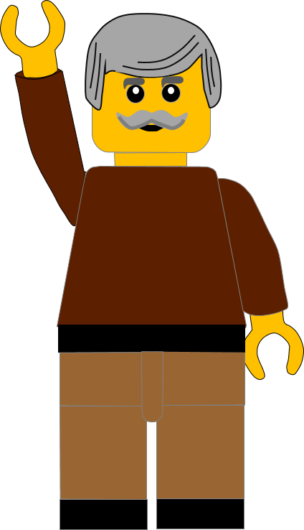
Whoops!
That’s not quite right.
Try again.
Click to return to the quiz

