Slide 1
Please click on the “slide show” tab on the top bar and “From Beginning” tab to start the Activity

Slide 2
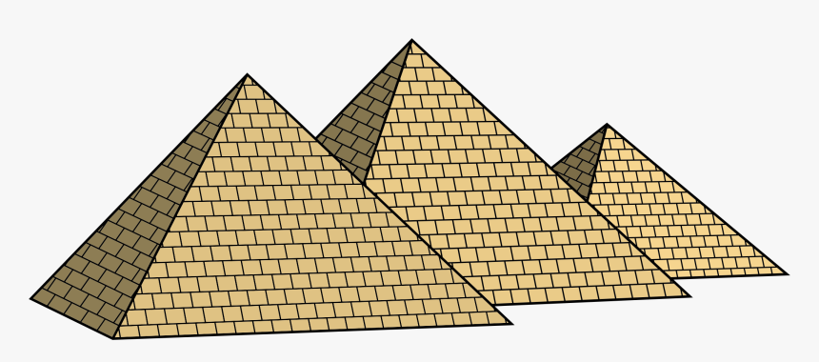
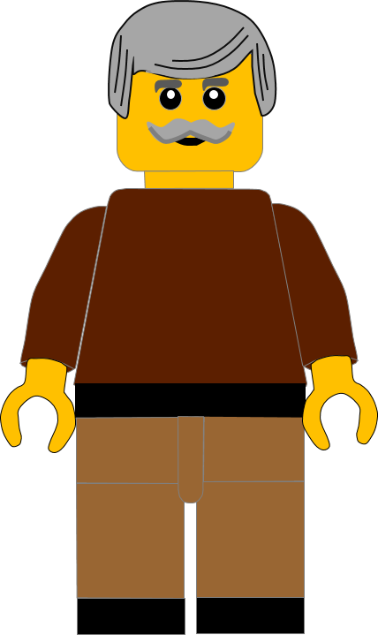
In this activity you will be given 10 questions about the story of Moses and the 10 commandments, which you can find in Exodus 20.
You will be given 3 possible answers to each question and you have to choose the right one.
Click here to start the quiz

Slide 3
Question 1:
In which book of the Bible do we find the story of Moses and the Ten Commandments?
Genesis
Exodus
Joshua
Press your answer

Slide 4
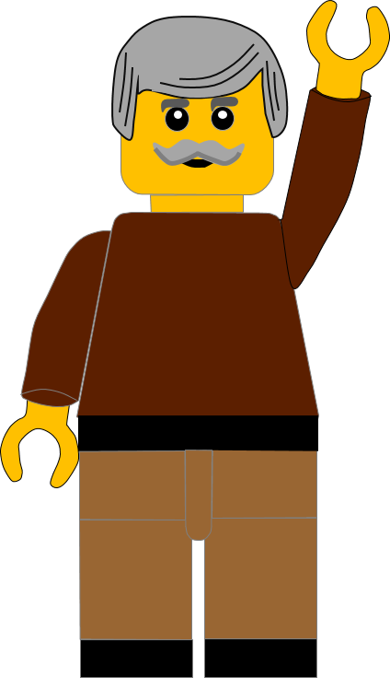
Question 1:
In which book of the Bible do we find the story of Moses and the Ten Commandments?
Genesis
Exodus
Joshua
You are right.
We find the story in the 2nd Book of the Bible: Exodus.
Well Done
Click for the next question

Slide 5
Question 2:
How did God lead the Israelites through the Wilderness?
An eagle
Satnav
A pillar of cloud
Press your answer

Slide 6
Question 2:
How did God lead the Israelites through the Wilderness?
An eagle
Satnav
A pillar of cloud
You are right.
A pillar of cloud led them through the wilderness.
Well Done
Click for the next question

Slide 7
Question 3:
What did the Israelites complain about in the wilderness?
Tiredness
Hunger
Sore feet
Press your answer

Slide 8
Question 3:
What did the Israelites complain about in the wilderness?
Tiredness
Hunger
Sore feet
You are right.
They complained about being hungry and thirsty.
Well Done
Click for the next question

Slide 9
Question 4:
What did God tell Moses to do to the stone to get water?
Hit it with his stick
Throw it in the lake
Break it into pieces
Press your answer

Slide 10
Question 4:
What did God tell Moses to do to the stone to get water?
Hit it with his stick
Throw it in the lake
Break it into pieces
You are right.
God told Moses to hit the stone with his stick, then water came out.
Well Done
Click for the next question

Slide 11
Question 5:
What was the name of the food God sent to the Israelites ?
Yeast
Chocolate
Manna
Press your answer

Slide 12
Question 5:
What was the name of the food God sent to the Israelites ?
Yeast
Chocolate
Manna
You are correct.
God sent Manna which means “What is it”.
Well Done
Click for the next question

Slide 13
Question 6:
What was the name of the Mountain where God spoke to Moses?
Sinai
Everest
Hermon
Press your answer

Slide 14
Question 6:
What was the name of the Mountain where God spoke to Moses?
Sinai
Everest
Hermon
You are right.
God spoke to Moses on Mount Sinai.
Well Done
Click for the next question

Slide 15
Question 7:
How long did the Israelites travel before they reached Mount Sinai?
3 years
3 months
3 weeks
Press your answer

Slide 16
Question 7:
How long did the Israelites travel before they reached Mount Sinai?
3 years
3 months
3 weeks
You are right.
The Israelites travelled 3 months before reaching Mount Sinai
Well Done
Click for the next question

Slide 17
Question 8:
What happened on the mountain after Moses came down?
Thunder and lightning
Earthquake
Volcano erupted
Press your answer

Slide 18
Question 8:
What happened on the mountain after Moses came down?
Thunder and Lightning
Earthquake
Volcano erupted
You are right.
There was thunder and lightning on the mountain.
Well Done
Click for the next question

Slide 19
Question 9:
What did Moses tell the Israelites about God?
He was very angry with them
He was leaving them
He wanted them as his people
Press your answer

Slide 20
Question 9:
What did Moses tell the Israelites about God?
He was very angry with them
He was leaving them
He wanted them as His people
You are right.
God has chosen them as His special people.
Well Done
Click for the next question

Slide 21
Question 10:
Why did God give Moses the Ten Commandments?
To show them how to live
To stop them having fun
To make hard rules for them
Press your answer

Slide 22
Question 10:
Why did God give Moses the Ten Commandments?
To show them how to live
To stop them having fun
To make hard rules for them
You are right.
God gave them the commandments so the could live together.
Well Done
Click for the next slide

Slide 23
Well done for finishing the quiz.
I’ll have another one for you next week.
See you next time

Slide 24
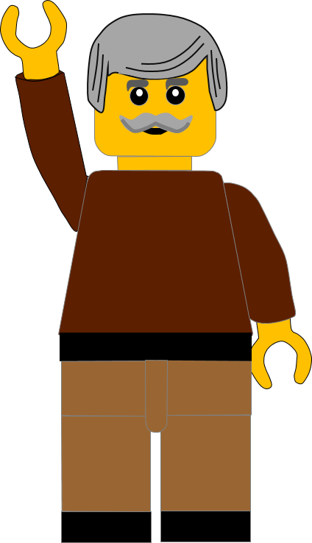
Whoops!
That’s not quite right.
Try again.
Click to return to the quiz

