Slide 1
Please click on the “slide show” tab on the top bar and “From Beginning” tab to start the Activity

Slide 2
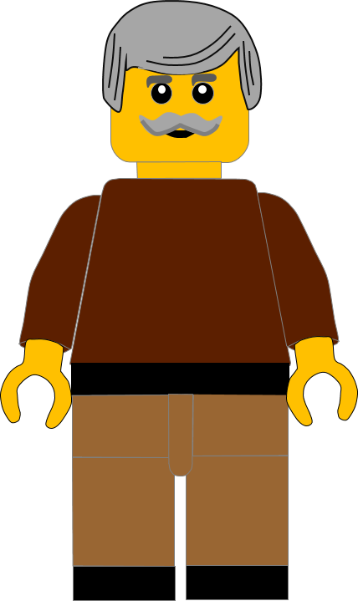
In this activity you will be given 10 questions about the story of Jesus calling Simon in
Luke chapter 5 v 1 - 11.
You will be given 3 possible answers to each question and you have to choose the right one.
Click here to start the quiz

Slide 3
Question 1:
Where was Jesus in our story today?
Temple
Sea of Galilee
Desert
Press your answer

Slide 4
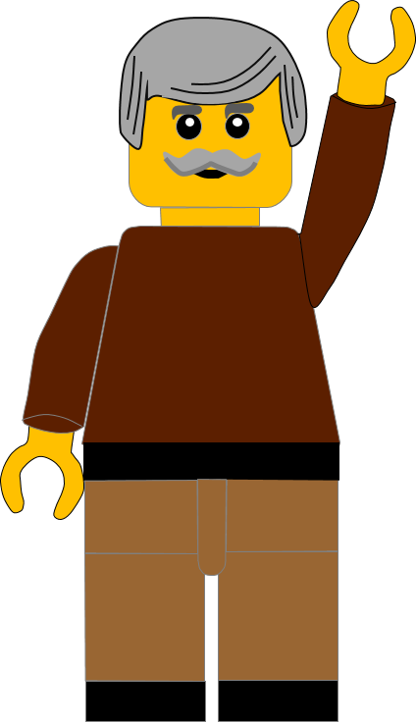
Question 1:
Where was Jesus in our story today?
Temple
Sea of Galilee
Desert
You are right.
Jesus had gone to the SEA of GALILEE.
Well Done
Click for the next question

Slide 5
Question 2:
What was Jesus doing by the Sea of Galilee?
He was teaching
He was
fishing
He was
praying
Press your answer

Slide 6
Question 2:
What was Jesus doing by the Sea of Galilee?
He was teaching
He was
fishing
He was
praying
You are correct.
Jesus was TEACHING the crowd who followed Him.
Well Done
Click for the next question

Slide 7
Question 3:
Why did Jesus get into the fishing boat?
The crowd were pressing Him.
He wanted to go for a boat ride.
He wanted to be a fisherman.
Press your answer

Slide 8
Question 3:
Why did Jesus get into the fishing boat?
The crowd were pressing Him.
He wanted to go for a boat ride.
He wanted to be a fisherman.
Fantastic answer.
The crowd was so big they were PRESSING Him .
Well Done
Click for the next question

Slide 9
Question 4:
Who did the boat belong to?
Samuel
Simon
Samson
Press your answer

Slide 10
Question 4:
Who did the boat belong to?
Samuel
Simon
Samson
Great answer.
The boat belonged to SIMON.
Well Done
Click for the next question

Slide 11
Question 5:
When he was finished teaching the crowd, where did Jesus tell Peter to take the boat?
Onto the beach
To the repair shop
Into deep water
Press your answer

Slide 12
Question 5:
When he was finished teaching the crowd, where did Jesus tell Peter to take the boat?
Onto the beach
To the repair shop
Into deep water
You are correct.
Jesus told Simon to take the boat into DEEP WATER.
Well Done
Click for the next question

Slide 13
Question 6:
What did Simon do when Jesus told Him to fish in deep water?
Stayed on the beach.
Obeyed Him.
Asked Jesus to get out.
Press your answer

Slide 14
Question 6:
What did Simon do when Jesus told Him to fish in deep water?
Stayed on the beach.
Obeyed Him.
Asked Jesus to get out.
You are right.
Peter OBEYED Jesus and did what he told him to do.
Well Done
Click for the next question

Slide 15
Question 7:
What happened when Simon obeyed Jesus?
They had empty nets.
A storm blew the boat away.
He caught many fish.
Press your answer

Slide 16
Question 7:
What happened when Simon obeyed Jesus?
They had empty nets.
A storm blew the boat away.
He caught many fish.
Spot on answer.
Simon CAUGHT SO MANY FISH that his nets began to break .
Well Done
Click for the next question

Slide 17
Question 8:
How did the fishermen feel when they saw all the fish?
Confused
Very pleased
Amazed
Press your answer

Slide 18
Question 8:
How did the fishermen feel when they saw all the fish?
Confused
Very pleased
Amazed
Great answer.
The fishermen were all AMAZED when they saw how many fish they had caught.
Well Done.
Click for the next question

Slide 19
Question 9:
Simon bowed down to Jesus and said he was what type of man?
Sinful man
Happy man
Thankful man
Press your answer

Slide 20
Question 9:
Simon bowed down to Jesus and said he was what type of man?
Sinful man
Happy man
Thankful man
Fantastic answer.
Simon told Jesus he was a SINFUL MAN, because he knew only God could do miracles.
Well Done
Click for the next question

Slide 21
Question 10:
What did Jesus tell Simon not to be?
Unhappy
Afraid
Sad
Press your answer

Slide 22
Question 10:
What did Jesus tell Simon not to be?
Unhappy
Afraid
Sad
That’s the right answer.
Jesus told him not to be AFRAID because he was going to serve God by catching men.
Well Done
Click for the next question

Slide 23
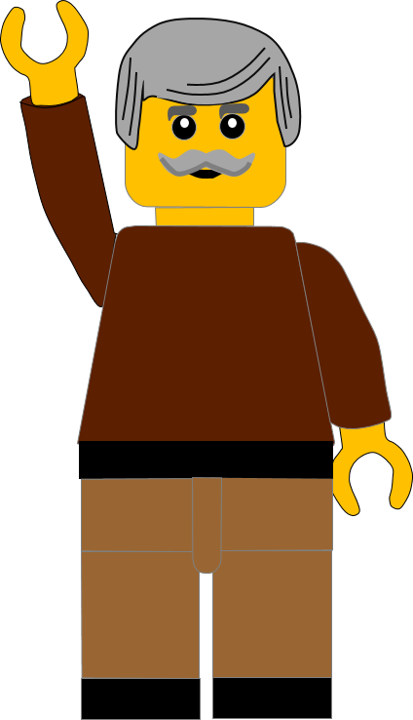
Well done for finishing the quiz.
I’ll have another one for you next week.
See you next time

Slide 24
Whoops!
That’s not quite right.
Try again.
Click to return to the quiz

