Slide 1
Please click on the “slide show” tab on the top bar and “From Beginning” tab to start the Activity

Slide 2
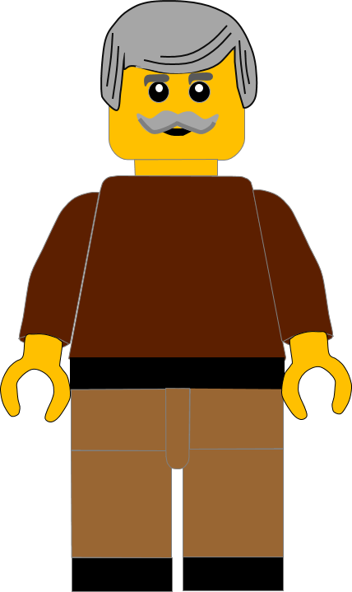
In this activity you will be given 10 questions about the story of Jesus being tempted in
Luke chapter 4 v 1 -13.
You will be given 3 possible answers to each question and you have to choose the right one.
Click here to start the quiz

Slide 3
Question 1:
Where was Jesus in our story today?
Temple
Wilderness
Jerusalem
Press your answer

Slide 4
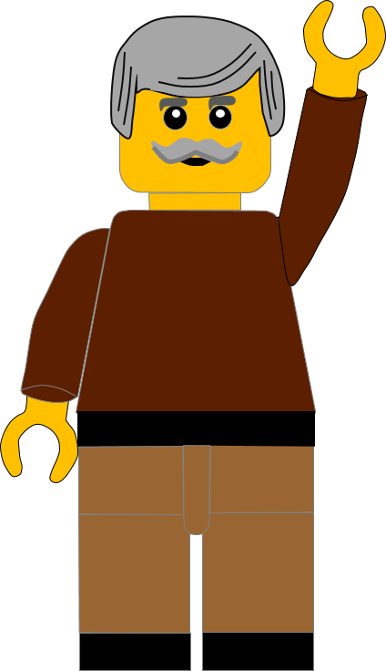
Question 1:
Where was Jesus in our story today?
Temple
Wilderness
Jerusalem
You are right.
Jesus had gone into the WILDERNESS.
Well Done
Click for the next question

Slide 5
Question 2:
What had happened just before Jesus went into the desert?
He was baptised
He was in prison
He was in the temple
Press your answer

Slide 6
Question 2:
What had happened just before Jesus went into the desert?
He was baptised
He was in prison
He was in the temple
You are correct.
Jesus was baptised in the River Jordan by John the Baptist.
Well Done
Click for the next question

Slide 7
Question 3:
How many days was Jesus in the wilderness?
40 days
14 days
4 days
Press your answer

Slide 8
Question 3:
How many days was Jesus in the wilderness?
40 days
14 days
4 days
Fantastic answer.
Jesus was in the wilderness for 40 DAYS.
Well Done
Click for the next question

Slide 9
Question 4:
What did the Devil tell Jesus to turn into bread?
Flour
Stones
Plants
Press your answer

Slide 10
Question 4:
What did the Devil tell Jesus to turn into bread?
Flour
Stones
Plants
Great answer.
The Devil told Jesus to turn STONES into bread.
Well Done
Click for the next question

Slide 11
Question 5:
What did Jesus say a person didn’t do by just eating bread?
Get stronger
Grow
Live
Press your answer

Slide 12
Question 5:
What did Jesus say a person didn’t do by just eating bread?
Get stronger
Grow
Live
You are correct.
Jesus said, “A person does not LIVE only by eating bread.”
Well Done
Click for the next question

Slide 13
Question 6:
What did the Devil ask Jesus to do in exchange for all the kingdoms?
Forgive Him
Bow down
Go away
Press your answer

Slide 14
Question 6:
What did the Devil ask Jesus to do in exchange for all the kingdoms?
Forgive Him
Bow down
Go away
You are right.
The Devil told Jesus to BOW DOWN to him in exchange for all the kingdoms.
Well Done
Click for the next question

Slide 15
Question 7:
Who did Jesus say you should worship?
Your parents
The king of the land
The Lord
your God
Press your answer

Slide 16
Question 7:
Who did Jesus say you should worship?
Your parents
The king of the land
The Lord
your God
Spot on answer.
Jesus said you should only worship and serve THE LORD YOUR GOD.
Well Done
Click for the next question

Slide 17
Question 8:
Where did the Devil take Jesus next?
River
Mountain
Temple
Press your answer

Slide 18
Question 8:
Where did the Devil take Jesus next?
River
Mountain
Temple
Great answer.
The Devil took Jesus to the top of the TEMPLE in Jerusalem.
Well Done.
Click for the next question

Slide 19
Question 9:
What did the Devil tell Jesus to do on the top of the temple?
Jump off
Pray
Look at the view
Press your answer

Slide 20
Question 9:
What did the Devil tell Jesus to do on the top of the temple?
Jump off
Pray
Look at the view
Fantastic answer.
The Devil told Jesus to JUMP OFF the temple because the angels would save Him.
Well Done
Click for the next question

Slide 21
Question 10:
What did Jesus tell the devil you shouldn’t do to God?
Follow
Test
Pray
Press your answer

Slide 22
Question 10:
What did Jesus tell the devil you shouldn’t do to God?
Follow
Test
Pray
That’s the right answer.
Jesus said, ”You must not TEST the Lord your God.”
Well Done
Click for the next question

Slide 23
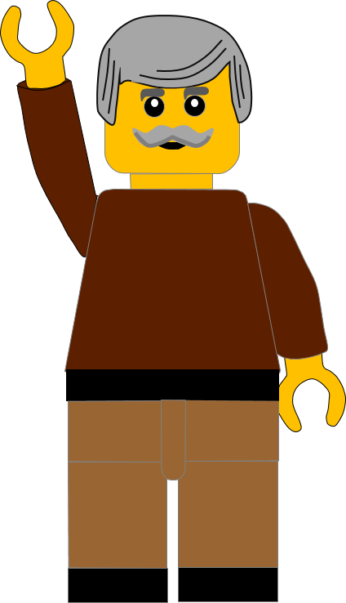
Well done for finishing the quiz.
I’ll have another one for you next week.
See you next time

Slide 24
Whoops!
That’s not quite right.
Try again.
Click to return to the quiz

