Slide 1
Please click on the “slide show” tab on the top bar and “From Beginning” tab to start the Activity

Slide 2
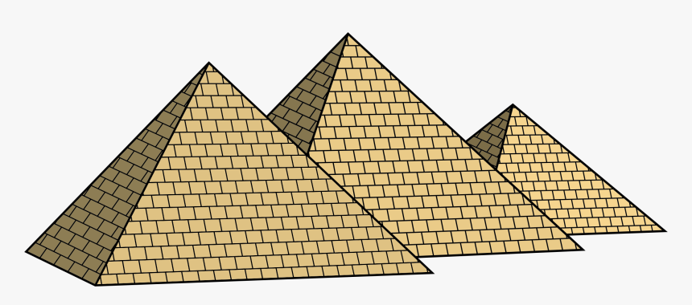
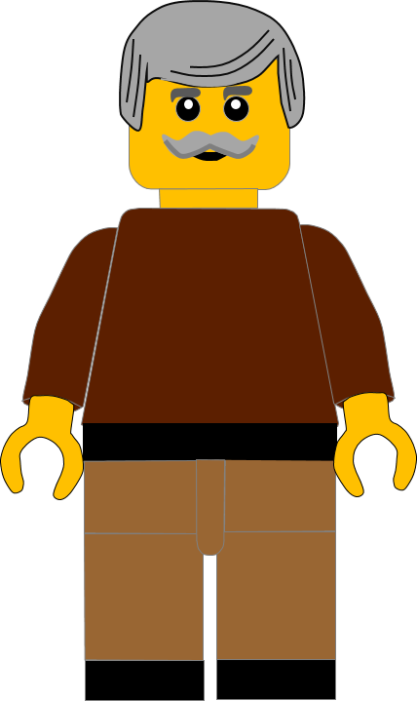
In this activity you will be given 10 questions about the story of Moses and the Golden Calf, which you can find in Exodus 32.
You will be given 3 possible answers to each question and you have to choose the right one.
Click here to start the quiz

Slide 3
Question 1:
In today’s story what place had the Israelites got to ?
Egypt
Galilee
Mount Sinai
Press your answer

Slide 4
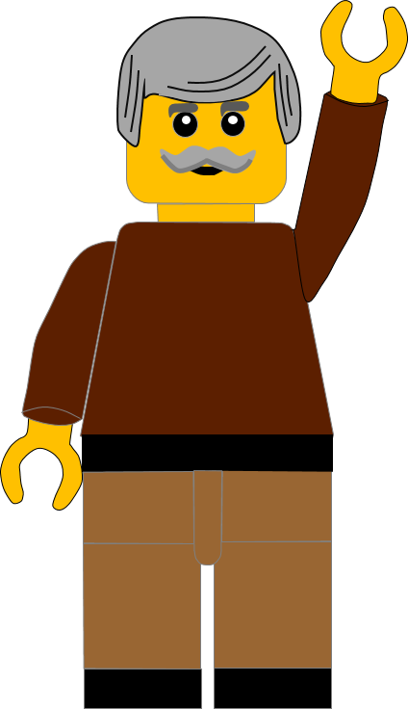
Question 1:
In today’s story what place had the Israelites got to ?
Egypt
Galilee
Mount Sinai
You are right.
The Israelites were camped below Mount Sinai.
Well Done
Click for the next question

Slide 5
Question 2:
Where had Moses gone?
Up the mountain
Into the desert
Back to Egypt
Press your answer

Slide 6
Question 2:
Where had Moses gone?
Up the mountain
Into the desert
Back to Egypt
You are right.
Moses had gone up the mountain to speak with God.
Well Done
Click for the next question

Slide 7
Question 3:
Who did the Israelites ask to make them a god?
Joshua
Aaron
Joseph
Press your answer

Slide 8
Question 3:
Who did the Israelites ask to make them a god?
Joshua
Aaron
Joseph
You are right.
They asked Moses’ brother Aaron to make the idol.
Well Done
Click for the next question

Slide 9
Question 4:
What metal did Aaron use to make the idol?
Gold
Silver
Bronze
Press your answer

Slide 10
Question 4:
What metal did Aaron use to make the idol?
Gold
Silver
Bronze
You are right.
Aaron used gold to make the idol.
Well Done
Click for the next question

Slide 11
Question 5:
Where did Aaron get the gold to make the idol?
Gold mine
Gold earrings
Gold coins
Press your answer

Slide 12
Question 5:
Where did Aaron get the gold to make the idol?
Gold mine
Gold earrings
Gold coins
You are correct.
The Israelites gave their gold earrings and Aaron melted the gold.
Well Done
Click for the next question

Slide 13
Question 6:
What animal was the idol like?
Lion
Sheep
Calf
Press your answer

Slide 14
Question 6:
What animal was the idol like?
Lion
Sheep
Calf
You are right.
The idol was in the shape of a golden calf.
Well Done
Click for the next question

Slide 15
Question 7:
What did God tell Moses he was going to do to the Israelites?
Give them more Manna
Destroy them
Take them to Egypt
Press your answer

Slide 16
Question 7:
What did God tell Moses he was going to do to the Israelites?
Give them more Manna
Destroy them
Take them to Egypt
You are right.
God said he was going to destroy the Israelites because they had sinned.
Well Done
Click for the next question

Slide 17
Question 8:
What did Moses ask God to do to the Israelites?
Destroy them
Forgive them
Forget them
Press your answer

Slide 18
Question 8:
What did Moses ask God to do to the Israelites?
Destroy them
Forgive them
Forget them
You are right.
Moses begged God to forgive the Israelites.
Well Done
Click for the next question

Slide 19
Question 9:
What did Moses do to the Golden Calf when he came down the mountain?
Took it
up the mountain
Threw it into the sea
Melted and crushed it
Press your answer

Slide 20
Question 9:
What did Moses do to the Golden Calf when he came down the mountain?
Took it
up the mountain
Threw it into the sea
Melted and crushed it
You are right.
Moses melted the idol and then crushed it into dust.
Well Done
Click for the next question

Slide 21
Question 10:
Moses put the gold dust into water and gave it to the Israelites to do what?
Wash
in it
Drink it
Throw it away
Press your answer

Slide 22
Question 10:
Moses put the gold dust into water and gave it to the Israelites to do what?
Wash
in it
Drink it
Throw it away
You are right.
Moses told the Israelites to drink the water.
Well Done
Click for the next slide

Slide 23
Well done for finishing the quiz.
I’ll have another one for you next week.
See you next time

Slide 24
Whoops!
That’s not quite right.
Try again.
Click to return to the quiz

