Slide 1
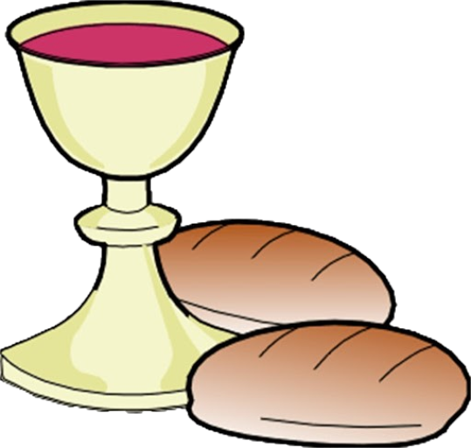
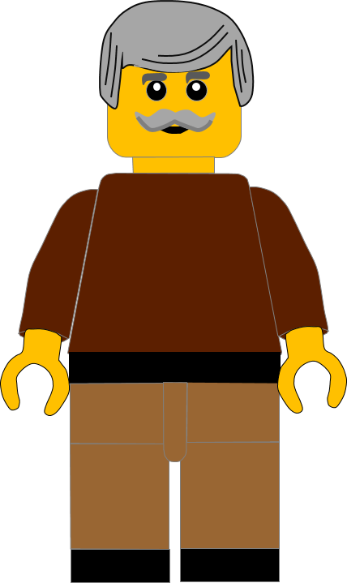
In this activity you will be given 10 questions about the story of Jesus celebrating the Passover in
Luke chapter 22 v 7 - 30.
You will be given 3 possible answers to each question and you have to choose the right one.
Click here to start the quiz

Slide 2
Question 1:
Which disciples did Jesus send to get the room ready?
Peter and John
James and John
Peter and Thomas
Press your answer

Slide 3
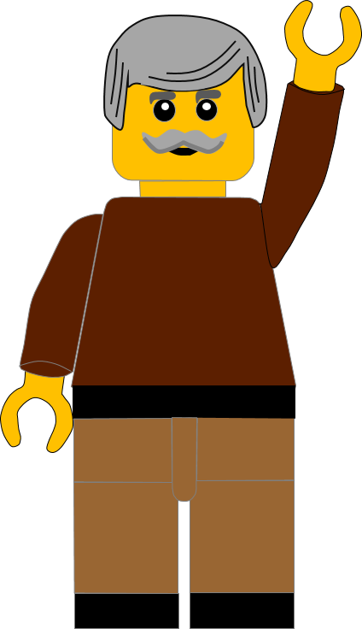
Question 1:
Which disciples did Jesus send to get the room ready?
Peter and John
James and John
Peter and Thomas
You are correct.
Jesus sent Peter and John to get the room ready.
Well Done
Click for the next question

Slide 4
Question 2:
What animal was sacrificed at Passover?
A donkey
A lamb
A cow
Press your answer

Slide 5
Question 2:
What animal was sacrificed at Passover?
A donkey
A lamb
A cow
You are right.
A LAMB was sacrificed at Passover.
Well Done
Click for the next question

Slide 6
Question 3:
What did Jesus tell the disciples the man would be carrying?
A jar of water
A shopping bag
A loaf of bread
Press your answer

Slide 7
Question 3:
What did Jesus tell the disciples the man would be carrying?
A jar of water
A shopping bag
A loaf of bread
Fantastic answer.
Jesus said the man would be carrying a JAR OF WATER.
Well Done
Click for the next question

Slide 8
Question 4:
Where was the room the man gave the disciples?
In the cellar
Downstairs
Upstairs
Press your answer

Slide 9
Question 4:
Where was the room the man gave the disciples?
In the cellar
Downstairs
Upstairs
Fantastic answer.
The man had prepared the UPSTAIRS room for the Passover meal.
Well Done
Click for the next question

Slide 10
Question 5:
What did Jesus do when he took the wine cup?
Gave it to Peter
Gave thanks to God
Gave it to Judas
Press your answer

Slide 11
Question 5:
What did Jesus do when he took the wine cup?
Gave it to Peter
Gave thanks to God
Gave it to Judas
Great answer.
Jesus took the cup and GAVE THANKS TO GOD.
Well Done
Click for the next question

Slide 12
Question 6:
After Jesus gave thanks for the bread,
what did he do with the bread?
Put it back on the plate
Dunked it in the wine
Broke it
Press your answer

Slide 13
Question 6:
After Jesus gave thanks for the bread,
what did he do with the bread?
Put it back on the plate
Dunked it in the wine
Broke it
You are correct.
After Jesus had given thanks for the bread, he BROKE IT.
Well Done
Click for the next question

Slide 14
Question 7:
What did Jesus say the bread was?
His gift
His body
His supper
Press your answer

Slide 15
Question 7:
What did Jesus say the bread was?
His gift
His body
His supper
You are right.
Jesus said the bread was HIS BODY.
Well Done
Click for the next question

Slide 16
Question 8:
What did Jesus say the blood represented?
People’s lives
The best wine
His blood
Press your answer

Slide 17
Question 8:
What did Jesus say the blood represented?
People’s lives
The best wine
His blood
Spot on answer.
Jesus said the blood represented HIS BLOOD.
Well Done
Click for the next question

Slide 18
Question 9:
Who did Jesus say the cup showed?
How good the supper was
The generosity of the man
God’s new agreement
Press your answer

Slide 19
Question 9:
Who did Jesus say the cup showed?
How good the supper was
The generosity of the man
God’s new agreement
Great answer.
Jesus said the cup showed GOD’S NEW AGREEMENT with people.
Well Done.
Click for the next question

Slide 20
Question 10:
Jesus said the new agreement begins with His blood being ...?
Painted on the door posts
Poured out for people
Put in a wine bottle
Press your answer

Slide 21
Question 10:
Jesus said the new agreement begins with His blood being ...?
Painted on the door posts
Poured out for people
Put in a wine bottle
That’s the right answer.
Jesus said the new agreement begins with His blood being POURED OUT FOR YOU.”
Well Done
Click for the next question

Slide 22
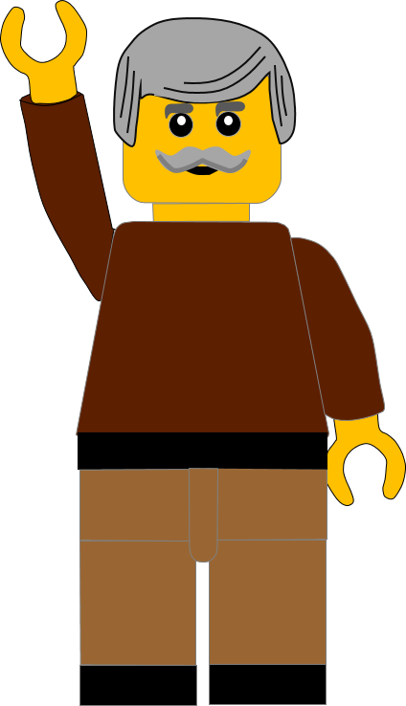
Well done for finishing the quiz.
I’ll have another one for you next week.
See you next time

Slide 23
Whoops!
That’s not quite right.
Try again.
Click to return to the quiz

