Slide 1
Please click on the “slide show” tab on the top bar and “From Beginning” tab to start the Activity

Slide 2
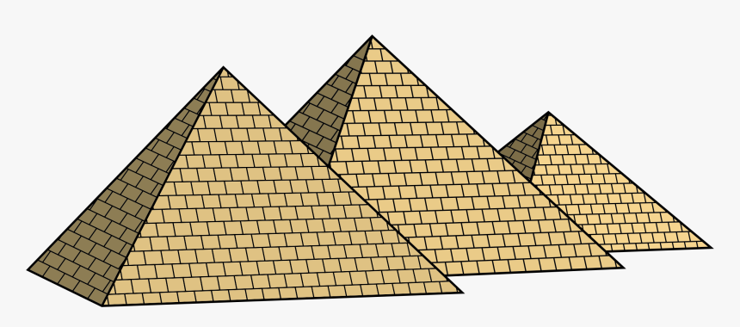
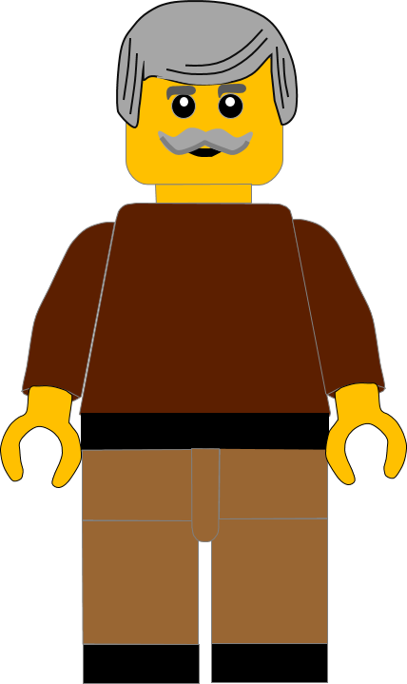
In this activity you will be given 10 questions about the story of Moses and the 3rd and 4th Commandments, which you can find in Exodus 20.
You will be given 3 possible answers to each question and you have to choose the right one.
Click here to start the quiz

Slide 3
Question 1:
Moses told the Israelites they must not use God’s name . . . .?
Unkindly
Foolishly
Thoughtlessly
Press your answer

Slide 4
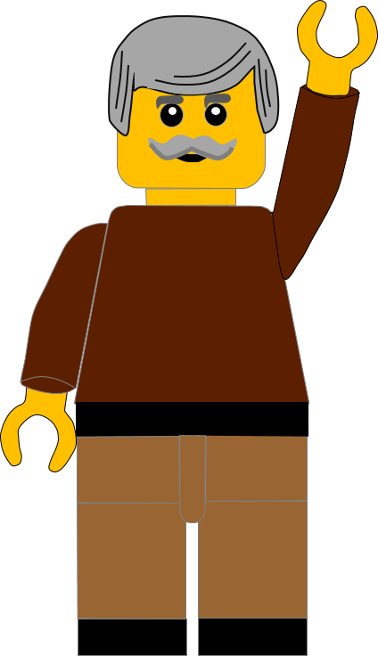
Question 1:
Moses told the Israelites they must not use God’s name . . . .?
Unkindly
Foolishly
Thoughtlessly
You are right.
Moses told the Israelites not to use God’s name thoughtlessly.
Well Done
Click for the next question

Slide 5
Question 2:
How many days did God spend making everything?
Sixteen
Six
Sixty
Press your answer

Slide 6
Question 2:
How many days did God spend making everything?
Sixteen
Six
Sixty
Great answer.
The Bible tells us God spent 6 days making everything.
Well Done
Click for the next question

Slide 7
Question 3:
What did God do on the 7th day?
Rested
Went to sleep
Went on holiday
Press your answer

Slide 8
Question 3:
What did God do on the 7th day?
Rested
Went to sleep
Went on holiday
You are right.
The Bible tells us God rested on the 7th day.
Well Done
Click for the next question

Slide 9
Question 4:
What was the name given to the 7th day that means “rest”?
Special
Sabbath
Seventh
Press your answer

Slide 10
Question 4:
What was the name given to the 7th day that means “rest”?
Special
Sabbath
Seventh
You are right.
The 7th day is called the Sabbath.
Well Done
Click for the next question

Slide 11
Question 5:
What is the most important thing to do on the Sabbath day?
Spend time doing exercise
Spend time with God
Spend time with our friends
Press your answer

Slide 12
Question 5:
What is the most important thing to do on the Sabbath day?
Spend time doing exercise
Spend time with God
Spend time with our friends
You are right.
The most important thing to do on the Sabbath is spend time with God.
Well Done
Click for the next question

Slide 13
Question 6:
In our story today about Jesus, where was Jesus?
In the Synagogue
In the market
By the fishing
boats
Press your answer

Slide 14
Question 6:
In our story today about Jesus, where was Jesus?
In the Synagogue
In the market
By the fishing
boats
You are correct.
Jesus had gone to the synagogue.
Well Done
Click for the next question

Slide 15
Question 7:
What day did Jesus go to the synagogue?
Monday
Thursday
Sabbath
Press your answer

Slide 16
Question 7:
What day did Jesus go to the synagogue?
Monday
Thursday
Sabbath
Great answer.
Jesus went to the synagogue on the Sabbath.
Well Done
Click for the next question

Slide 17
Question 8:
Which people were looking for a reason to accuse Jesus?
Some Egyptians
Some Romans
Some Jews
Press your answer

Slide 18
Question 8:
Which people were looking for a reason to accuse Jesus?
Some Egyptians
Some Romans
Some Jews
You are right.
Some Jews wanted to accuse Jesus of doing wrong.
Well Done
Click for the next question

Slide 19
Question 9:
What was wrong with the man Jesus met in the synagogue?
He had a crippled hand
He had a crippled foot
He was blind
Press your answer

Slide 20
Question 9:
What was wrong with the man Jesus met in the synagogue?
He had a crippled hand
He had a crippled foot
He was blind
Super answer.
The man had a crippled or withered hand.
Well Done
Click for the next question

Slide 21
Question 10:
What type of things did Jesus say we could do on the Sabbath?
Exciting
Good
Happy
Press your answer

Slide 22
Question 10:
What type of things did Jesus say we could do on the Sabbath?
Exciting
Good
Happy
Super answer.
Jesus said we should do GOOD things on the Sabbath.
Well Done
Click for the next question

Slide 23
Well done for finishing the quiz.
I’ll have another one for you next week.
See you next time

Slide 24
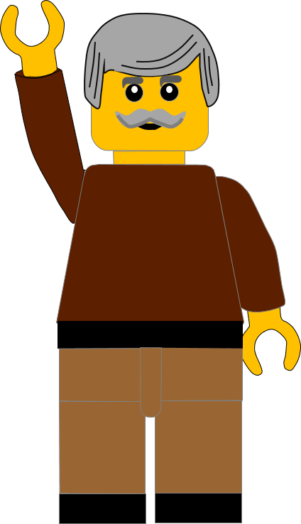
Whoops!
That’s not quite right.
Try again.
Click to return to the quiz

