Slide 1
Good Morning Please click on the slide show icon on the top bar to start the Powerpoint Presentation
©

Slide 2
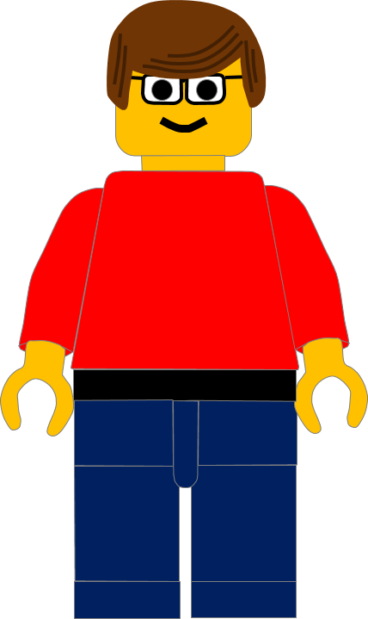
Good Morning!
I hope you have had a good week.
Click here to go to the next slide

Slide 3
This week we have 2 videos for you to watch.
There are some songs and a magic show in the videos too.
Click here to go to the next slide

Slide 4
There are 2 sets of videos:
the first set are for younger children.
The second set are for school y4/5/6.
Why not watch one video, do an activity and then watch the second video.
Click here to go to the next slide

Slide 5
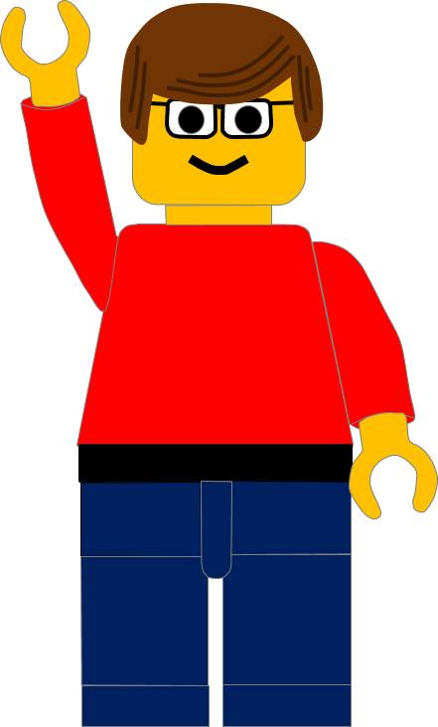
Enjoy the videos. See you next week.

