Slide 1
Good Morning Please click on the slide show icon on the top bar to start the Powerpoint Presentation
©

Slide 2
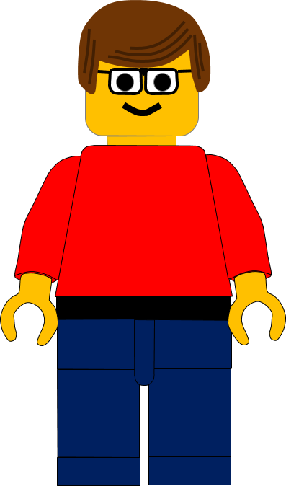
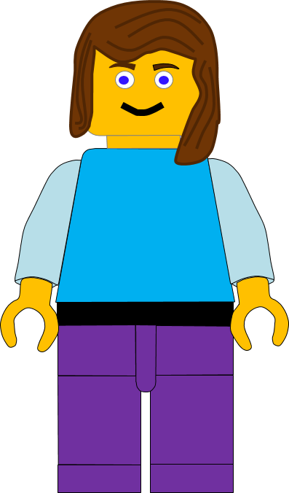
Good Morning!
Welcome to Hillcliffe
Junior Church Online.
Today we are going to look at another of Jesus’ healing miracles.
Click here to go to the next slide

Slide 3
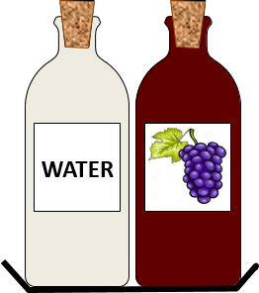
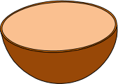
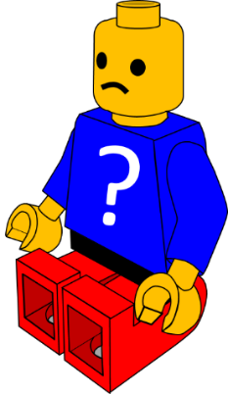
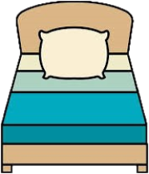
So far, we have looked at 10 miracles.
Can you remember them all?
Click on a clue if you want a reminder.
Click here to go to the next slide

Slide 4
The miracle we learnt about last week was amazing!
Jesus made the girl live again!
That’s right.
The girl died while Jesus was on his way to heal her… but he then made her live again
Click here to go to the next slide

Slide 5
It really was amazing!
Only Jesus could do that!
This week’s miracle is even more amazing!
Let’s sing first and then watch the video.
Click here to go to the next slide

Slide 6
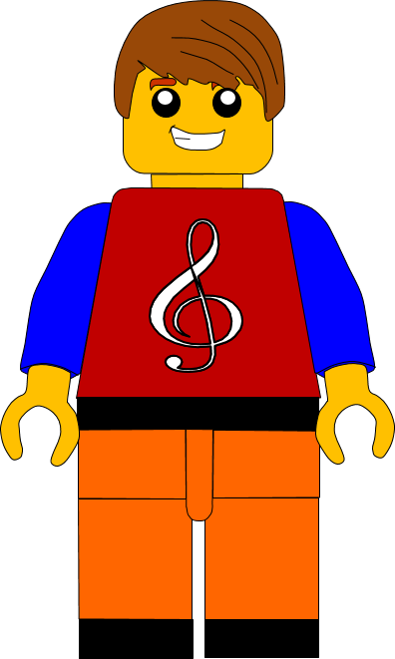
Hello have you got some songs for us this morning?
I have and
I hope everyone likes them.
Click here to go to the next slide

Slide 7
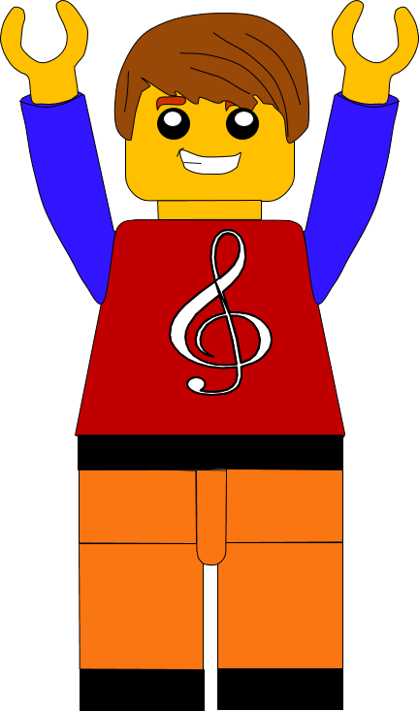
This week we have 3 songs.
I think you know all of them.
When I look
God, You’re good to me
One Way
Click here to go to the next slide

Slide 8
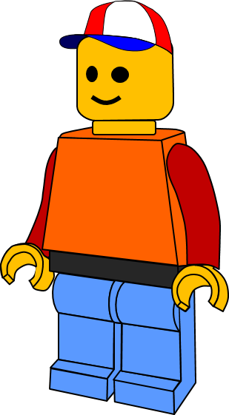
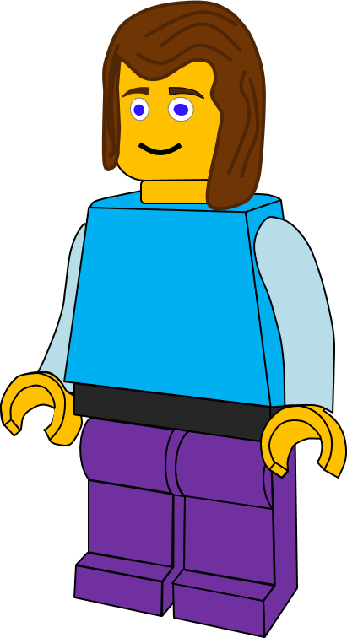
I’m really tired jumping up and down.
I agree, we need a rest now.
Well you can have a rest watching the video.
Can you get it for me please?
OK
Click here to go to the next slide

Slide 9
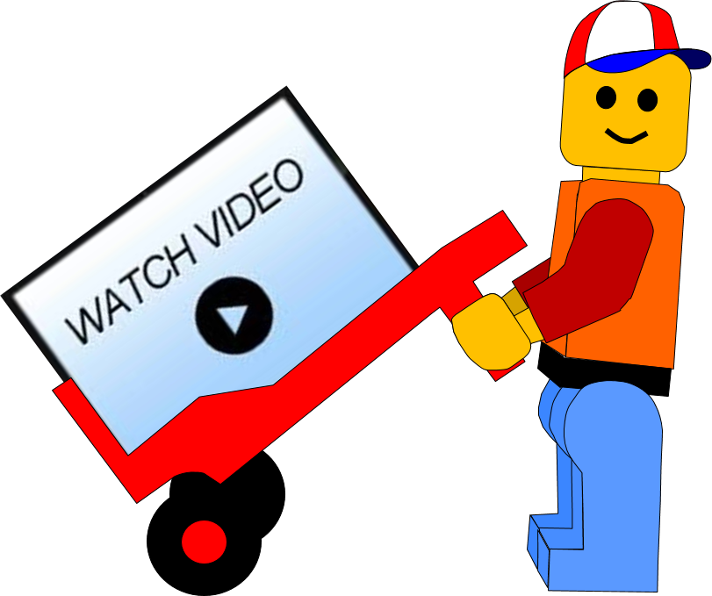
Click here to go to the next slide

Slide 10
What was Jesus doing in today’s story?
He was going with the disciples to a town called Nain.
I know, was he going to a town?
Click here to go to the next slide

Slide 11
What happened just before Jesus got to the town called Nain?
Did he meet someone?
Yes he met a funeral.
A woman’s son had died.
Click here to go to the next slide

Slide 12
This was very sad. The woman’s husband had also died, so she had no one left in her family.
She didn’t know what to do or who to ask for help.
But Jesus showed he had compassion and cared for her.
Click here to go to the next slide

Slide 13
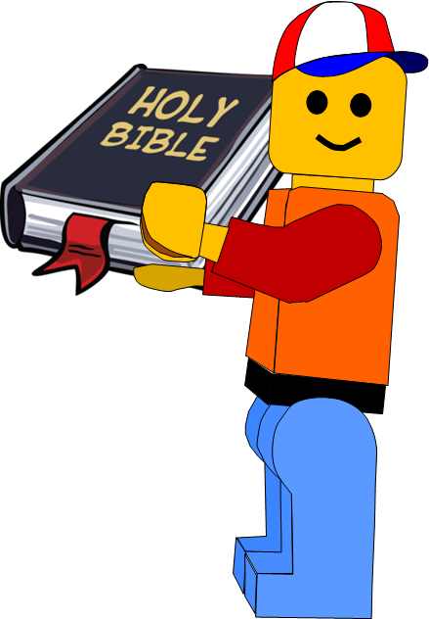
Luke chapter 7 verses 11 - 13
The next day Jesus went to a town called Nain. His followers and a large crowd were travelling with him.
When he came near the town gate, he saw a funeral.
A mother, who was a widow, had lost her
only son. A large crowd from the town
was with the mother while her son was
being carried out.
When the Lord saw her, he felt very sorry
for her. Jesus said to her, “Don’t cry.”
Click here to go to the next slide

Slide 14
How do you think the woman felt when Jesus told her “Don’t cry.”
She would be confused because she was very upset.
Perhaps she had heard about Jesus and trusted him?
Click here to go to the next slide

Slide 15
Luke chapter 7 verses 14 - 17
He went up to the coffin and touched it. The men who were carrying it stopped. Jesus said, “Young man, I tell you, get up!” And the son sat up and began to talk.
Then Jesus gave him back to his mother.
All the people were amazed. They began
praising God. They said, “A great prophet
has come to us! God is taking care of his people.”
This news about Jesus spread through all Judea
and into all the places around there.
Click here to go to the next slide

Slide 16
This boy hadn’t just died like Jairus’ daughter. He had been dead a few days
But Jesus showed again that his power was greater than death.
He showed that he cared for the lady too.
Click here to go to the next slide

Slide 17
You are right!
This parable also shows us that Jesus really cares and loves people . . .
. . . and he cares and loves us too.
Click here to go to the next slide

Slide 18
So let’s go over today’s points again
1
Jesus showed that he had power over death.
2
Jesus cared and had compassion for the lady. He solved her problem.
3
Jesus cares and has love for us.
He wants to solve
our problems.
Click here to go to the next slide

Slide 19
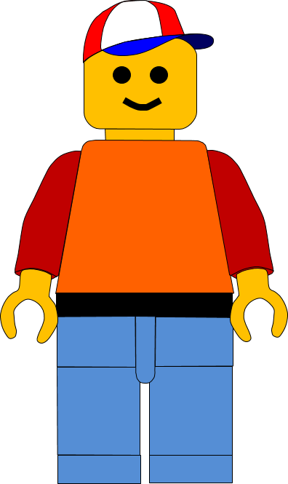
Let’s share our problems with Jesus now
Amen
Dear God, thank you for loving and caring for us so much.
Help us to share our problems
with you now.
. . . . . . . . . .
. . . . . . . . . .
. . . . . . . . . .
Amen
Click here to go to the next slide

Slide 20
Do you remember the last verse today?
This news about Jesus spread through all Judea and into all the places around there.
It spread because it was good news.
So, we should spread the good news about Jesus to our family and friends.
Click here to go to the next slide

Slide 21
This verse wasn’t in our reading today, but it tells us how much God loves us.
Click here to go to the next slide

Slide 22
Activities today All of the activities today are available as downloadable documents on the Sunday’s Online website page. We hope you enjoy them. Go to the next page if you want a preview.
Click here to go to the next slide

Slide 23
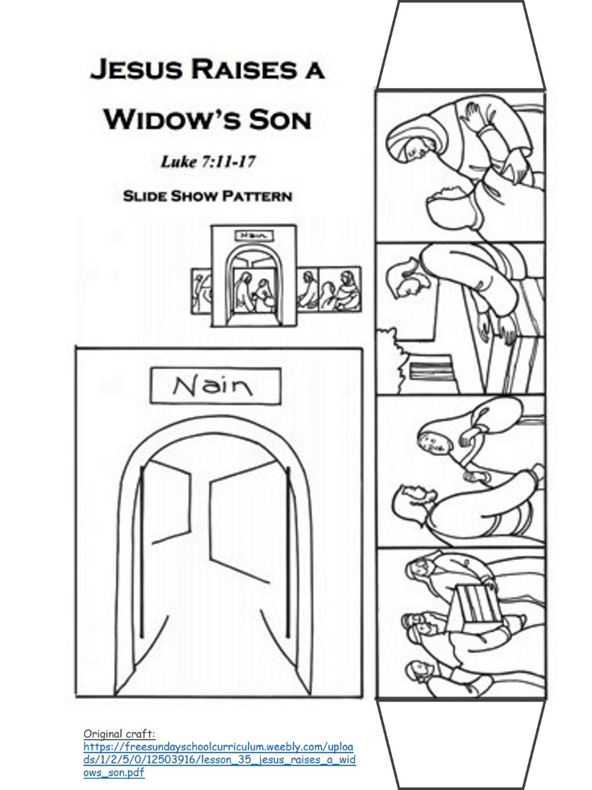
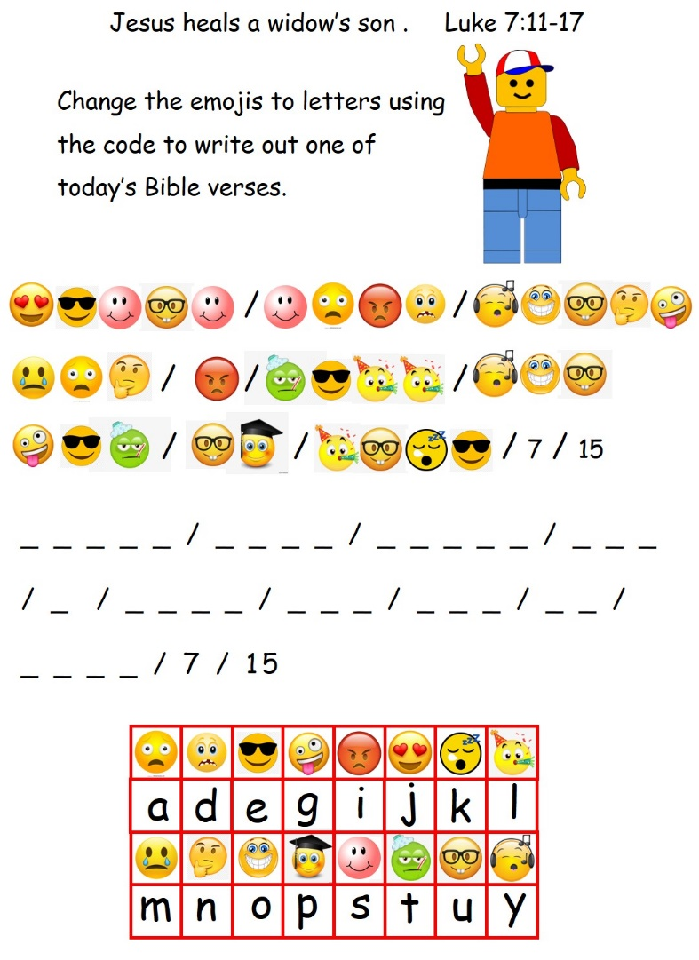
Moving story Activity
Code Activity
Click here to go to the next slide

Slide 24
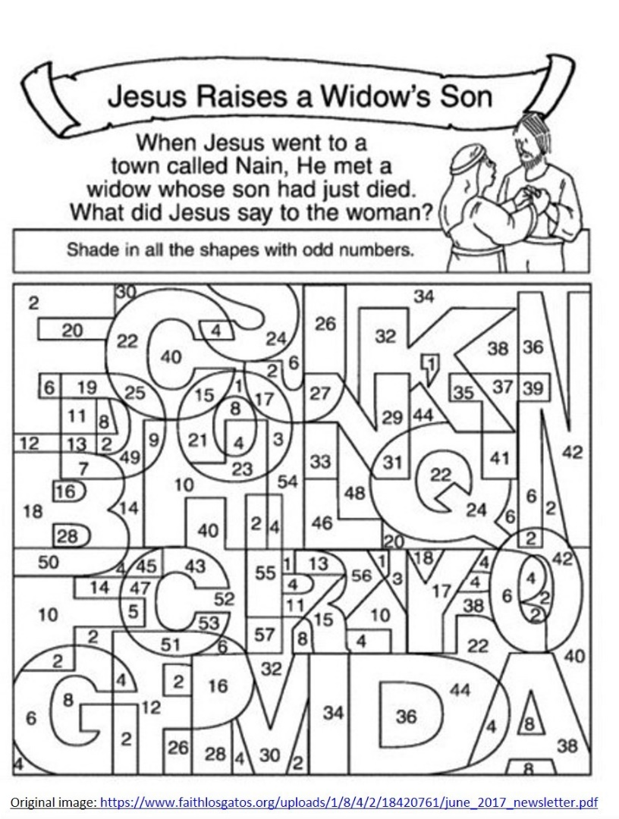
Hidden words activity
Letter puzzle activity
Click here to go to the next slide

Slide 25
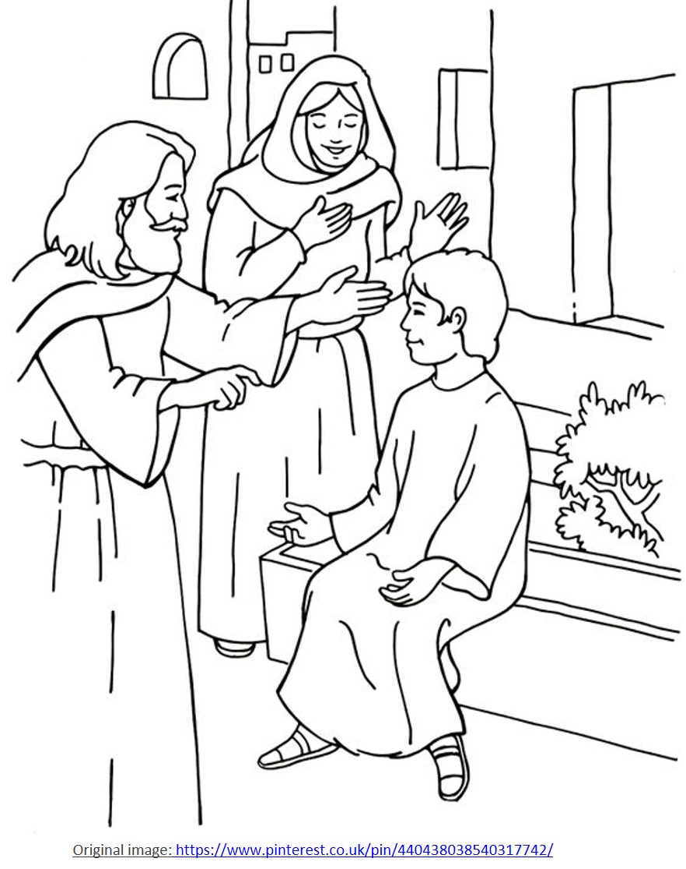
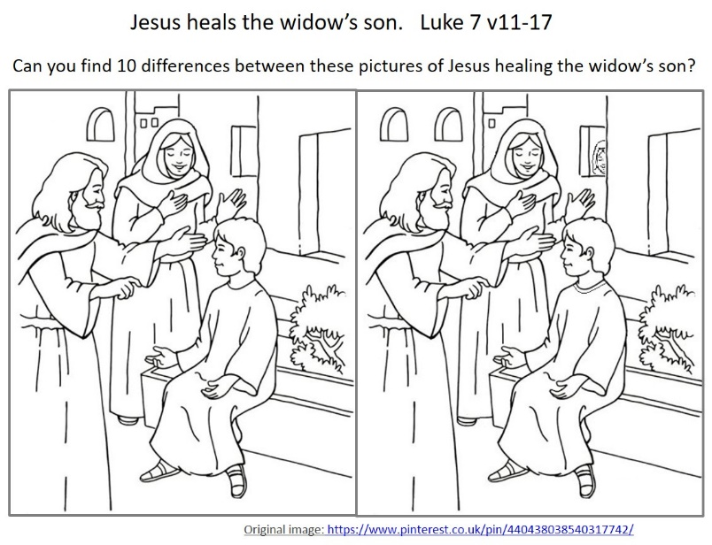
Spot the difference
Colouring activity
Click here to go to the next slide

Slide 26
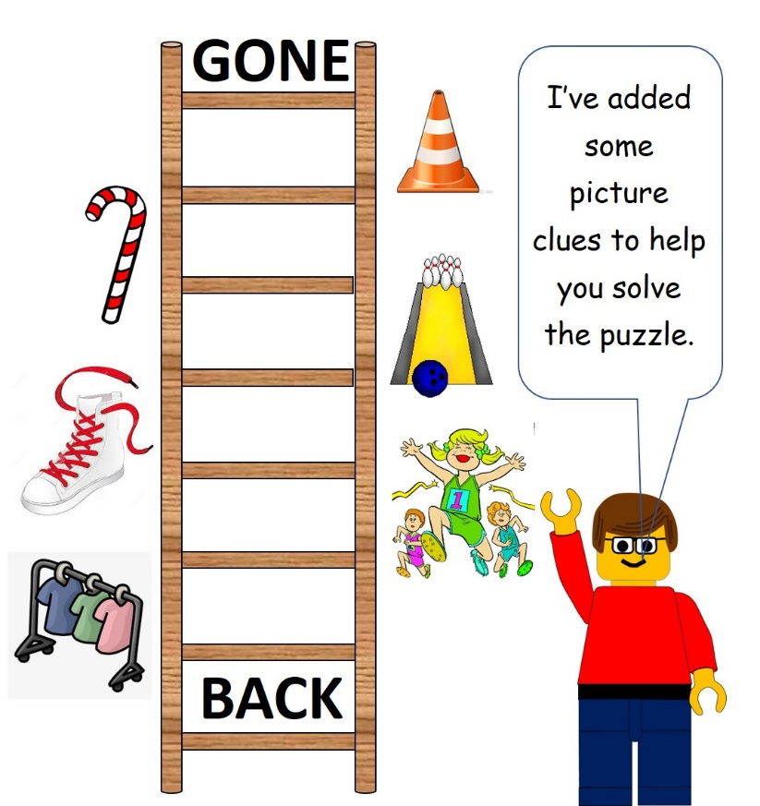
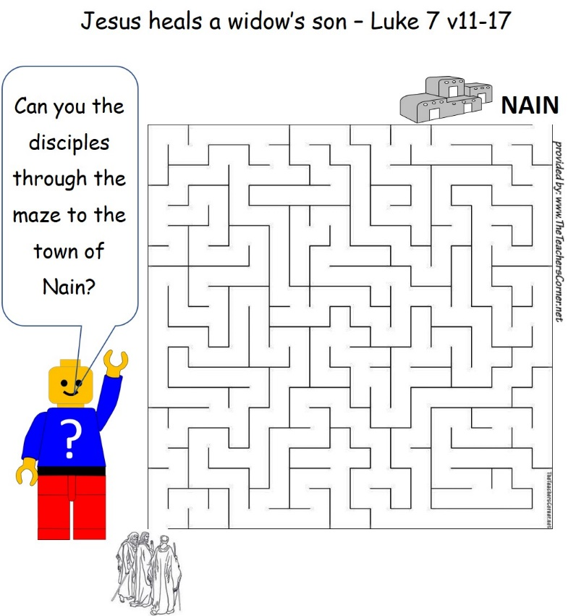
Word ladder activity
Maze activity
Click here to go to the next slide

Slide 27
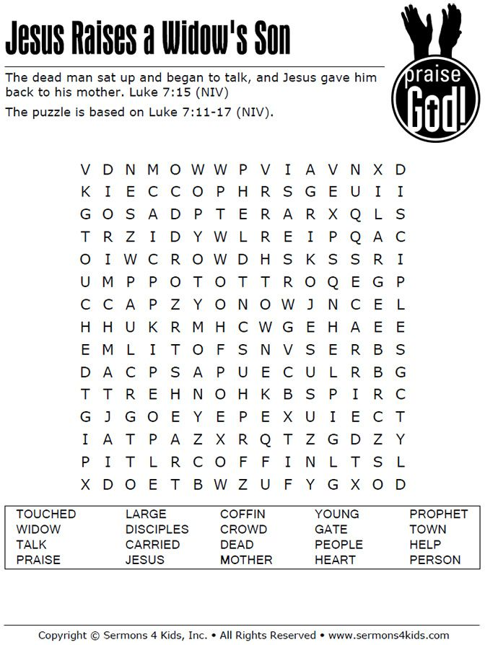
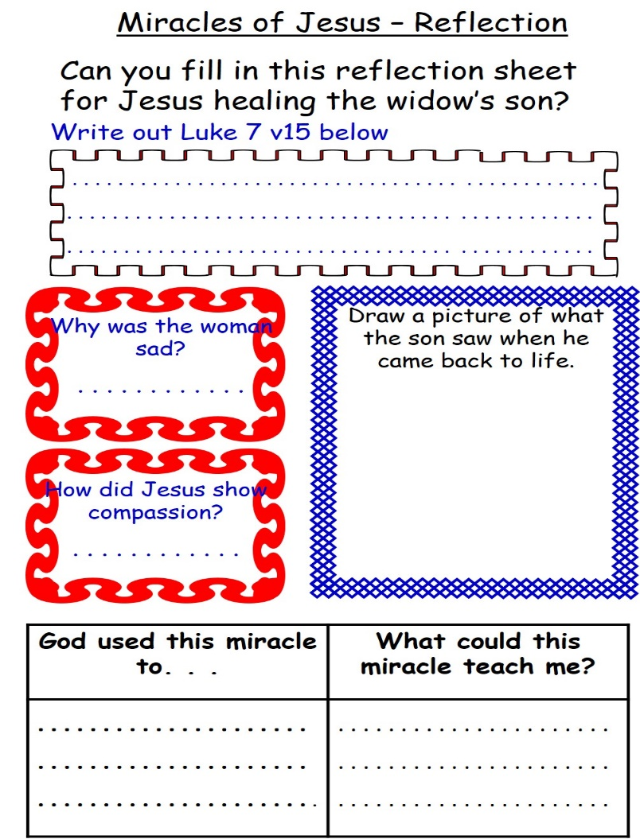
Wordsearch
Reflection
Click here to go to the next slide

Slide 28
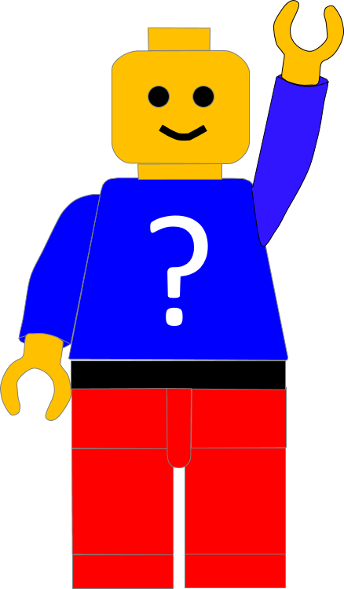
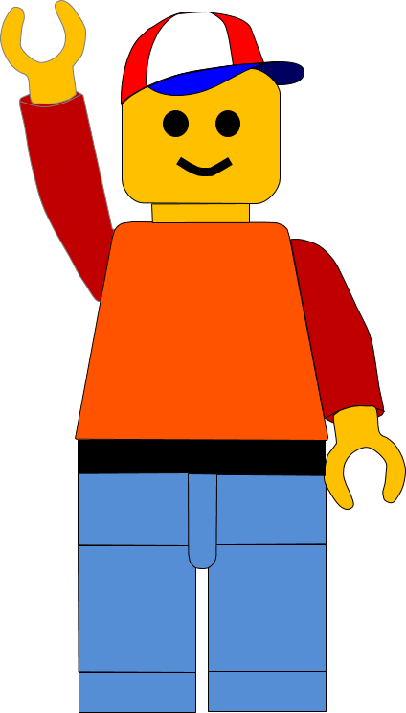
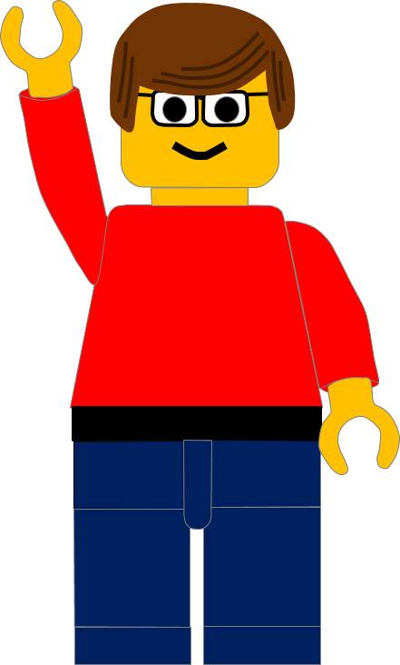
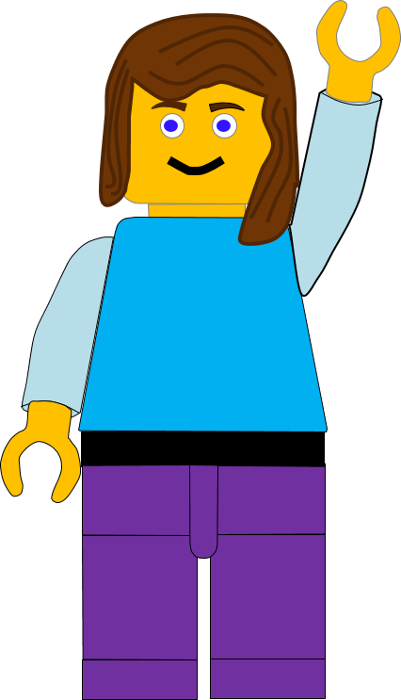
Bye. See you next week

Slide 30
The water and wine, reminded us of Jesus’ miracle at the wedding.
The miracle showed us, Jesus had the power to change real objects.
Click here to go back to the last slide

Slide 31
The bread and fish remind us of the miracle of Jesus feeding 5000 people.
The miracle showed us Jesus could use the things we have for His work.
Click here to go back to the last slide

Slide 32
The rolled up mat reminds us of Jesus’ miracle healing the paralyzed man.
Jesus said he could forgive our sins. This miracle showed that he could.
Click here to go back to the last slide

Slide 33
The bell reminds us of Jesus’ miracle healing the 10 lepers.
Jesus said he could really forgive and heal us, if we believed and followed him
Click here to go back to the last slide

Slide 34
The beggar’s bowl reminds us of Jesus’ miracle healing the blind man.
Jesus gave the man back his sight and showed he could help us see God
Click here to go back to the last slide

Slide 35
The big fish in the net reminds us of the miracle of the Big Catch
Jesus showed the disciples he would give them everything they needed if they followed Him.
Click here to go back to the last slide

Slide 36
The sad Lego Man reminded
us of the man at
the Pool of Betheda –
he couldn’t reach the water
Jesus healed the man and told him to stop sinning
Click here to go back to the last slide

Slide 37
The life belt reminds us of Jesus walking on water and rescuing Simon Peter.
Jesus wants us to trust and follow him even when things might get hard.
Click here to go back to the last slide

Slide 38
The umbrella reminds us of Jesus calming the storm and rescuing the disciples.
Jesus is always there for us and wants us to trust Him in everything we do.
Click here to go back to the last slide

Slide 39
The bed reminds us of Jesus bringing Jairus’ daughter back to life, after she had died.
Jesus showed that he had power greater than death, and wants us to trust him even when things seem impossible.
Click here to go back to the last slide

